Slide 1
Developing ChatBot 3-2 Set ChatBot with API.AI
Refresh-Foods Inc.
Yestin Yehoon Lee

Slide 2
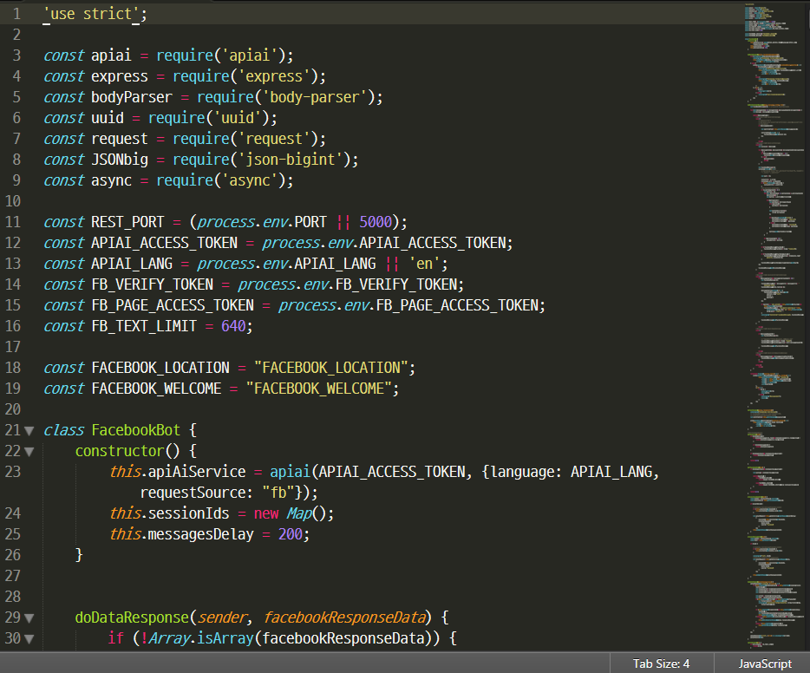
Check Source Code
Downloaded from api-ai

Slide 3
Push Code to Server
git add .
git commit –m ‘use api.ai’
git push Heroku master

Slide 4
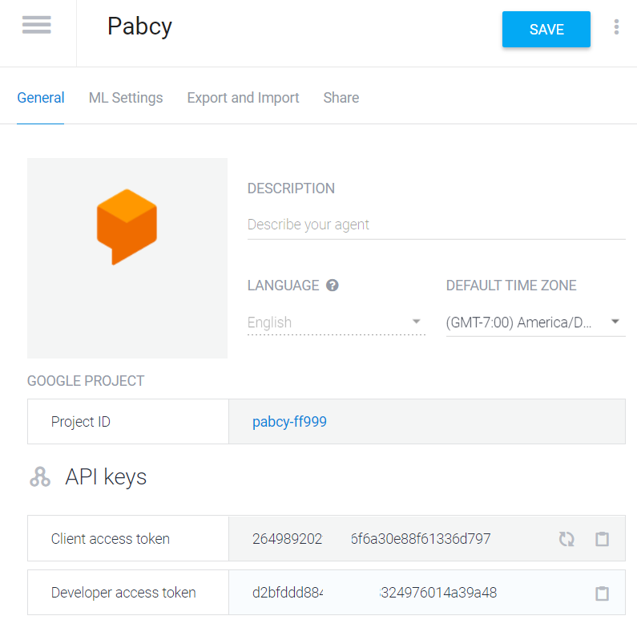
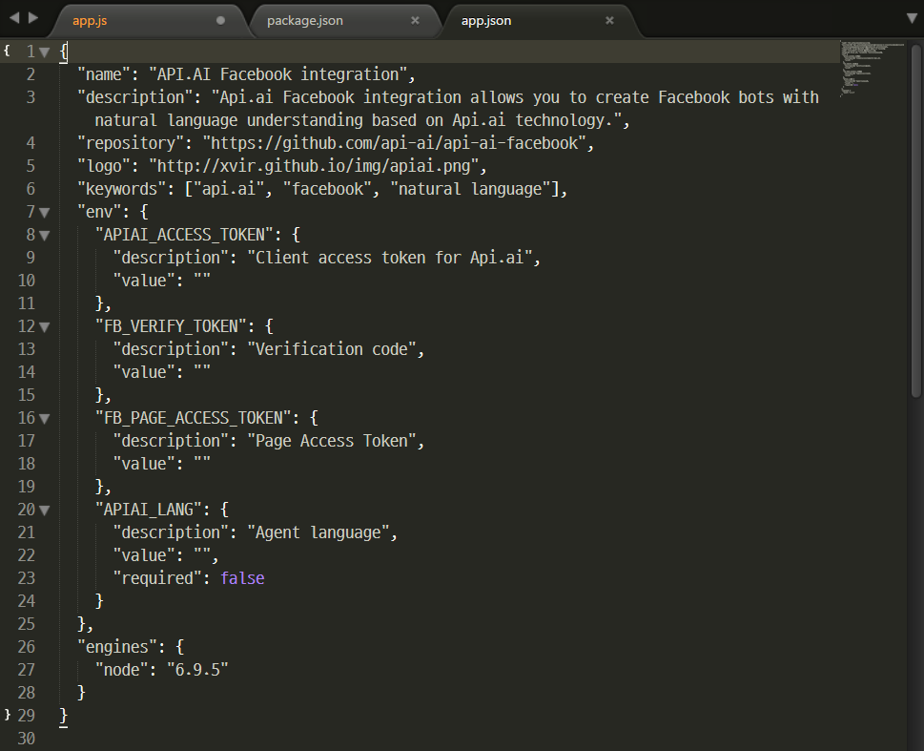
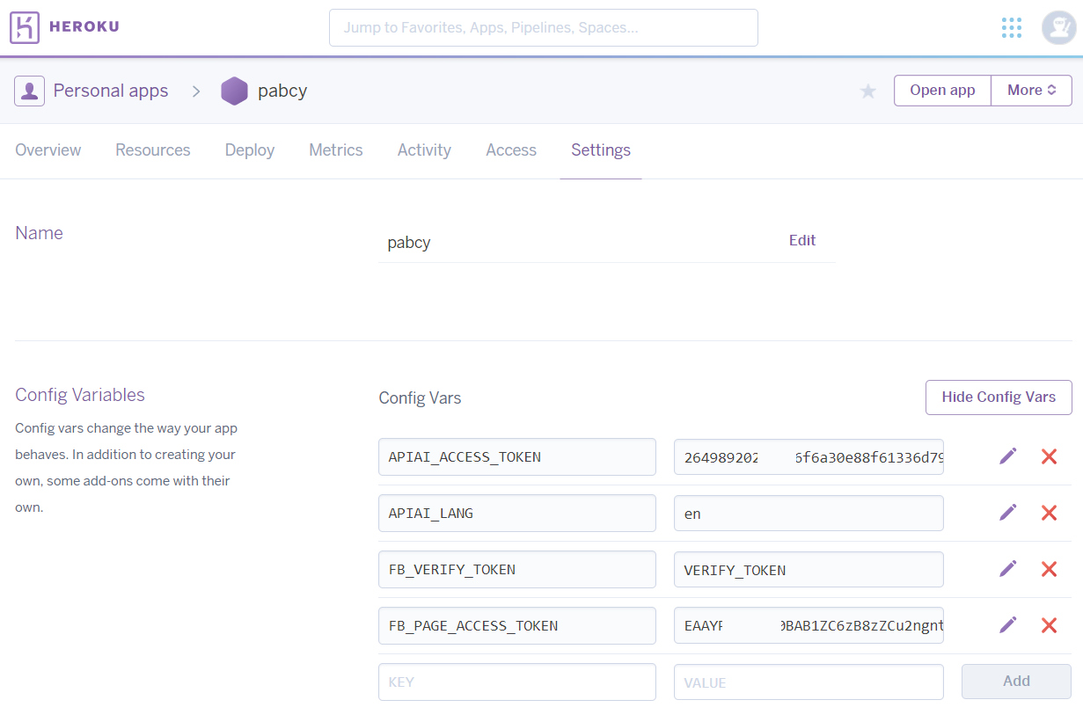
Config Variables
Open app.json
Get api.ai token
Get Facebook token
Set config variables in Heroku
Notes:
Open app.json
Get api.ai token
Get Facebook token – already got at 1-3
Set config variables in Heroku

Slide 5

How API.AI Connected
API.AI
Facebook
Local
Heroku
Sendgrid
User
Developer
Server
Email
Twilio
SMS
Notes:
API.AI, Facebook page, Heroku server
are connected with token verify

